Slide 1
SRDS 2013
Symposium on Reliable Distributed Systems
Braga, Portugal
Vision and Priorities for Cloud Computing
2 October 2013
Francisco.Medeiros@ec.europa.eu
European Commission
DG CONNECT
Deputy Head of Unit E2
Software & Services, Cloud Computing

Slide 2
Vision and Priorities for Cloud Computing
Commission Communication of 27 September 2012
  http://eur-lex.europa.eu/LexUriServ/LexUriServ.do?uri=COM:2012:0529:FIN:EN:PDF
"EU Cloud Strategy"
Strategy designed to speed up the adoption and increase the use of cloud computing across all sectors of the economy
  http://europa.eu/rapid/press-release_IP-12-1025_en.htm

Slide 3
Expected benefits
Motivation for fast adoption of cloud computing
  Cost savings in the deployment of IT services (infrastructures, installations, human resources)
  Forecast of expenditure for 'public cloud' services in the EU until 2020:
  http://ec.europa.eu/information_society/activities/cloudcomputing/docs/quantitative_estimates.pdf
    €35 billion without policy intervention
    €78 billion if appropriate policy initiatives are implemented
  Impact in all sectors of the economy
  Increase of the EU GDP in the year 2020 due to cloud computing:
  €88 billion without policy intervention
  €250 billion if appropriate policy initiatives are implemented
Job creation* in the EU related to cloud computing until 2020
    1.3 million without policy intervention
    3.8 million if appropriate policy initiatives are implemented
* Productivity increases due to the widespread use of cloud computing services, may also lead to job losses or displacement (relocation) of jobs. Nevertheless, the net effect is likely to be positive

Slide 4
Cloud strategy: three key actions
Cutting through the jungle of technical standards: so that cloud users benefit from interoperability, data portability and reversibility; promotion of EU-wide voluntary certification schemes for trustworthy providers
Safe and fair contract terms and conditions: development of model contracts for cloud computing services, including Service Level Agreements
European Cloud Partnership between the public sector and industry to harness the public sector procurement power (20% of all IT spending); boosting the chances for European cloud providers to grow and to achieve competitive scale, in order to deliver cheaper and better eGovernment services

Slide 5
Impact on providers and users
Many potential users still associate cloud computing with increased risks, such as: protection of personal data, security, guarantee of continuity of services, legal jurisdiction, etc.
Supply side: new business opportunities for telecom operators, cloud services providers , equipment manufacturers and system integrators
Demand side: increased productivity, enhanced competitiveness, less risks in the use of IT services, fast speed* in the implementation of advanced IT services (especially for start-ups and SMEs)
Boston Consulting Group: 70% of CIOs indicated that 'fast implementation speed' was the main factor in their
decision to use cloud computing solutions

Slide 6
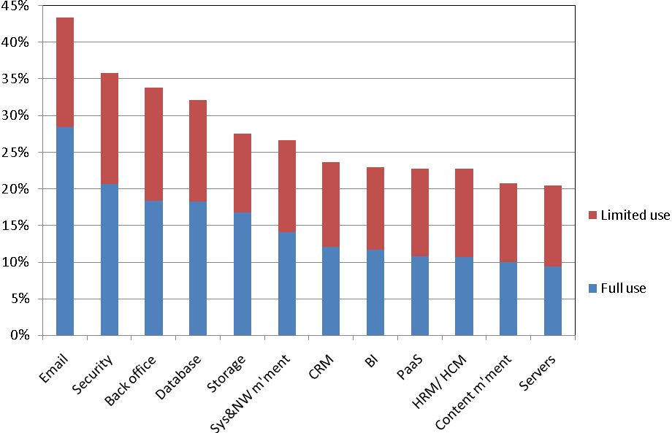
Adoption levels of different types of cloud services
Source: IDC, 2012
Sample: 1056 organisations
Geography: CZ, FR, DE, IT, HU, ES, SE, UK
Vertical axis = % of responses
CRM = customer relationship management
BI = business intelligence
PaaS = application development and testing
HRM = human resources management
HCM = human capital management
  http://ec.europa.eu/information_society/activities/cloudcomputing/docs/quantitative_estimates.pdf

Slide 7
Main barriers restricting cloud adoption
Multiple legal jurisdictions
Security and data protection
Trust
Data access and portability
Data location
Local support
  http://ec.europa.eu/information_society/activities/cloudcomputing/docs/quantitative_estimates.pdf

Slide 8
Digital Agenda for Europe (DAE)
The DAE review adopted on 18 December 2012 identified seven key areas for further efforts to stimulate the conditions to create growth and jobs in Europe:
1. A new and stable broadband regulatory environment
2. New public digital service infrastructures through Connecting Europe Facility loans
3. Launch a Grand Coalition on Digital Skills and Jobs
4. Propose a EU cyber-security strategy and a Directive
5. Update the EU's Copyright Framework
6. Accelerate cloud computing through the public sector buying power
7. Launch a new electronics industrial strategy – an "Airbus of Chips"
http://ec.europa.eu/digital-agenda/en/news/digital-do-list-new-digital-priorities-2013-2014
Original DAE launched on 19 May 2010
http://eur-lex.europa.eu/LexUriServ/LexUriServ.do?uri=COM:2010:0245:FIN:EN:PDF

Slide 9
Top priorities of the revised DAE
European Commission Vice President Neelie Kroes: "2013 will be the busiest year yet for the Digital Agenda. My top priorities are to increase broadband investment and to maximise the digital sector contribution to Europe's recovery"
Key area #6: accelerate cloud computing adoption through the public sector procurement power
The Commission will launch pilot actions in the context of the European Cloud Partnership, which harness public procurement power to help create the world's largest cloud-enabled ICT market, dismantling current national fortresses and negative consumer perceptions

Slide 10
Digital economy
The digital economy is growing at seven times the rate of the rest of the economy, but this potential is currently held back by a patchy pan-European policy framework
Gartner (3 January 2013): worldwide IT spending is projected to grow by 4.2% in 2013, in contrast with a much lower growth of the global economy
OECD growth forecast in 2013: average of 1.4% for its 34 member countries
Gartner (3 January 2013): forecast of worldwide IT spending in 2013: $3700 billion, including: devices ($666B), data centre systems ($147B), enterprise software ($296B), IT services ($927B) and telecom services ($1701B)
OECD = Organisation for Economic Co-operation and Development

Slide 11
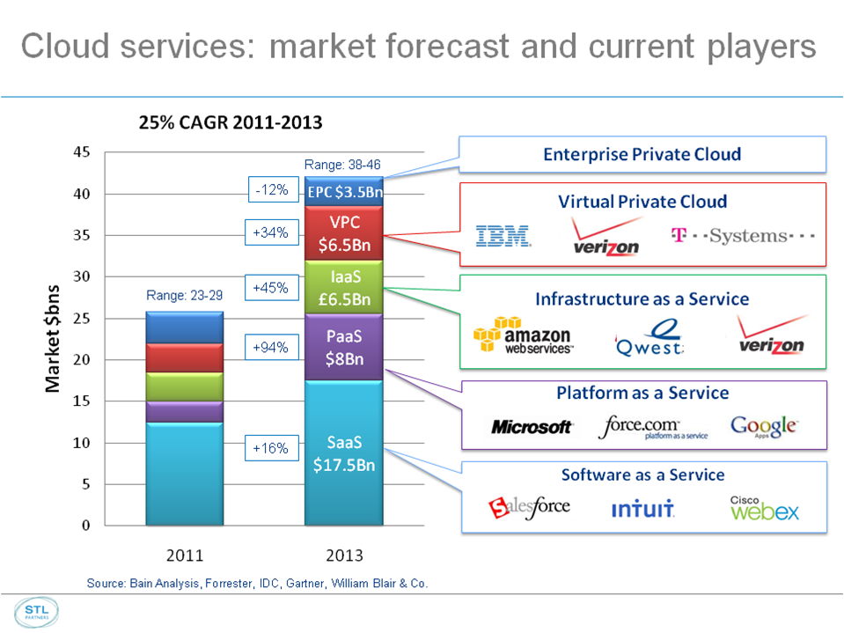
Cloud computing services market
Global cloud computing market in 2013
451 Market Monitor: from $8.7B in 2010 to $16.7B in 2013
MarketsandMarkets: from $5.6B in 2012 to $46.8B in 2013

Slide 12
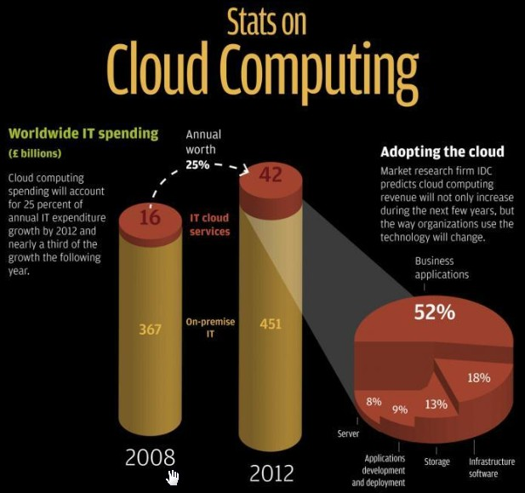

Estimates in GBP
£42.0B = US$67.2B
Growth (2012): $84B + $26B = $110B
Growth (2013): 2/3x + 1/3x = x

Slide 13
Who were the top players in 2012?
10. Vmware
9. Microsoft
8. Bluelock
7. Citrix
6. Joyent
5. Verizon/Terremark
4. Salesforce
3. CenturyLink/Savvis
2. Rackspace
1. Amazon Web Services (AWS)
Source: http://cdn.ttgtmedia.com/rms/pdf/scc_eguide_counting_down_top10_cloud.pdf

Slide 14
Amazon Web Services (#1)
Data from analysts (Macquarie Capital) published in January 2013: the top 200 accounts in one of the AWS sales region in the US spent amounts varying between $5,000 and $200,000 per month: SMEs?
Market for the type of services offered by AWS in 2012: $11.0 billion
AWS estimated revenue in 2012: $2.0 billion (18% market share)
Forecast for AWS revenues:
  2013: $3.8 billion (growth = 90%)
  2014: $6.2 billion (growth = 63%)
  2015: $8.8 billion (growth = 42%)
AWS cumulative revenues until 2020 (assuming zero growth after 2015): $63.0 billion
  Forecast of expenditure (source: IDC) with 'public cloud' services in the EU until 2020: between €35 billion and €78 billion

Slide 16
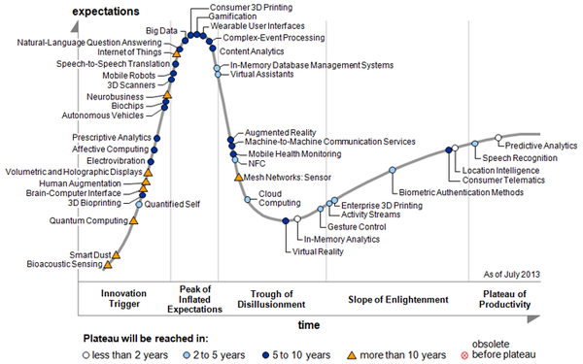
Source: Gartner, August 2013

Slide 17
1. On-going measures (DAE actions)
Opening up access to online content
  Promote content distribution models that enhance access to and use of all sorts of content (music, audio-visual, books) across different devices and in different territories
  The Commission is considering further actions to promote and facilitate the licensing of audiovisual works for online distribution, in particular across borders, as a follow up to the Audiovisual Green Paper [COM(2011)427 of 13 July 2011]
  http://eur-lex.europa.eu/LexUriServ/LexUriServ.do?uri=COM:2011:0427:FIN:EN:PDF
  Considering that consumers can use the cloud as a digital locker for content and as a synchronisation tool to access content from different devices, questions arise on the possible collection of private copy levies for any private copying of content to, from or within the cloud
  The Commission is assessing whether there is a need to clarify the scope of the private copying exception and the applicability of levies

Slide 18
2. On-going measures (DAE actions)
Make online and cross-border transactions straightforward
  Revision of the eCommerce Directive reaffirmed the role of electronic commerce as essential for the growth of digital services in Europe [COM(2011)942 of 11 January 2012]
  http://eur-lex.europa.eu/LexUriServ/LexUriServ.do?uri=COM:2011:0942:FIN:en:PDF
  Exemption from liability for information society services providers when they host or transmit illegal information that has been provided by a third party
  Complex value chains spanning multiple jurisdictions raise questions on the determination of the applicable law and the application of notification procedures concerning allegedly illegal information and activities. Follow up of COM(2011)942
  Adoption of common standards that permit safe use of services requiring reliable authentication and authorisation. Follow up of COM(2012)238 of 4 June 2012 (Regulation on eIdentification and Trust Services)
  http://eur-lex.europa.eu/LexUriServ/LexUriServ.do?uri=COM:2012:0238:FIN:EN:PDF
  General cyber security challenges addressed in the EU Strategy for Cyber Security [JOIN(2013)1 and COM(2013)48 of 7 February 2013]
  http://ec.europa.eu/digital-agenda/en/news/eu-cybersecurity-plan-protect-open-internet-and-online-freedom-and-opportunity-cyber-security
  http://ec.europa.eu/digital-agenda/en/news/eu-cybersecurity-plan-protect-open-internet-and-online-freedom-and-opportunity-cyber-security

Slide 19
3. On-going measures (DAE actions)
Building confidence on digital services
  Data protection = one of the main concerns likely to preclude the adoption of cloud computing services
  Faced with 28 partly diverging national legislative frameworks, it is difficult to provide cost effective cloud solutions at the level of the Digital Single Market
  Given the global scope of cloud computing, one needs clarity on how international data transfers will be regulated
  Proposed Regulation of the European Parliament and Council on the protection of individuals with regard to the processing of personal data and on the free movement of such data [COM(2012)11 of 25 January 2012]
  http://eur-lex.europa.eu/LexUriServ/LexUriServ.do?uri=COM:2012:0011:FIN:EN:PDF
  Regulation: enter into force simultaneously in all EU Member States; transposition into national law is not necessary

Slide 20
Key action 1: cutting through the jungle of standards
Public authorities have an important role in forging a trusted cloud environment in Europe (public procurement power)
  Chain of confidence-building steps to create trust in cloud solutions
  Identification of an appropriate set of standards that can be certified
  Giving confidence to public and private procurers that they have met their compliance obligations and are getting a cloud solution that meet their needs
The Commission tasked ETSI to coordinate with stakeholders, in a transparent and open way, a detailed map of the necessary standards (end of 2013)
  Security
  Interoperability
  Data reversibility
  Data portability

Slide 21
Cutting through the jungle of standards
Enhance trust by recognising at EU-level technical specifications in the field of ICT for the protection of personal information. Using the mechanism proposed by COM(2011)315 of 1 June 2011, in accordance with the Regulation …
http://eur-lex.europa.eu/LexUriServ/LexUriServ.do?uri=COM:2011:0315:FIN:EN:PDF
Regulation of the European Parliament and of the Council on European standardisation adopted on 25 October 2012, which entered into force on 1st January 2013
http://eur-lex.europa.eu/LexUriServ/LexUriServ.do?uri=OJ:L:2012:316:0012:0033:EN:PDF
Work with the support of ENISA and other relevant bodies to assist the development of EU-wide voluntary certification schemes in the area of cloud computing (including data protection) and establish a list of such schemes (end of 2014)
Address environmental challenges through agreements with industry on harmonised metrics for consumption (energy, water) and carbon emissions generated by the increased use of cloud services (end of 2014)

Slide 22
Key action 2: safe and fair contract terms and conditions (re: sales)
Develop, with stakeholders, model terms for cloud computing service level agreements (SLAs) for contracts between cloud providers and professional cloud users
In line with the Communication on a Common European Sales Law [COM(2012)225 of 22 May 2012], propose, to consumers and SMEs, model contract terms and conditions. The aim is to harmonise key contract terms and conditions on aspects related to the supply of digital content
http://ec.europa.eu/consumers/strategy/docs/consumer_agenda_2012_en.pdf
Task an expert group, including industry, to identify safe and fair contract terms and conditions for consumers and SMEs covering cloud-related issues that lie beyond the Common European Sales Law (optional instrument).

Slide 23
Key action 2: safe and fair contract terms and conditions (re: data)
Review the contractual clauses applicable to transfer of personal data to third countries and adapt these, as needed, to cloud services
Call upon national data protection authorities to approve Binding Corporate Rules (BCRs) for cloud providers. [BCRs are one of the means for legal international data transfers]
Work with industry to agree a Code of Conduct (CoC) for cloud providers to support a uniform application of data protection rules
Submit this CoC to the Article 29 Working Party for endorsement in order to ensure legal certainty and coherence between the CoC and EU law
Article 29 Working Party = independent group (advisory status)

Slide 24
Key action 3: promoting public sector leadership (Partnership)
Identification of public sector requirements for cloud services; develop specifications for the public procurement of IT services ; acquire 'reference implementations' in order to demonstrate conformance and performance
€10.0 million pre-commercial procurement (PCP) project, funded by the 7th Framework Programme for Research and Innovation. Formal launch on 14 November 2013 http://www.cloudforeurope.eu/
Advance towards joint procurement of cloud computing services by public bodies, based on common user requirements
Set up and execute other actions requiring coordination with public and private stakeholders (e.g. pilot initiatives)

Slide 25
European Cloud Partnership (ECP)
Name | Organization
Toomas Hendrik Ilves, Chair of the SB | President of Estonia
Reinhard Posch | Austria
Jérôme Filippini | France
Maarten Hillenaar | Netherlands
Katarina de Brisis | Norway
Aitor Cubo Contreras | Spain
Michael Hange | Germany
Andrzej Ręgowski | Poland
Pierre Nanterme | Accenture
Werner Vogels | Amazon
Thierry Breton | ATOS
Bernard Charles | Dassault
Michael Gorriz | Daimler
Hans Vestberg | Ericsson
Christian Fredrikson | F-Secure
Jim Hagemann-Snabe | SAP
Karl-Heinz Streibich | Software AG
Kate Craig-Wood | MEMSET
Vivek Dev | Telefónica Digital
Leo Apotheker | Ad personam

Slide 26
Select Industry Group (SIG)
Structured into 3 working groups (since January 2013):
  Service Level Agreements for cloud computing services
  https://ec.europa.eu/digital-agenda/en/cloud-select-industry-group-service-level-agreements
  Certification Schemes in the domain of cloud computing, including data protection
  https://ec.europa.eu/digital-agenda/en/cloud-select-industry-group-certification-schemes
  Code of Conduct for cloud providers with a view to support uniform application of data protection rules
  https://ec.europa.eu/digital-agenda/en/cloud-select-industry-group-code-conduct

Slide 27
Groups and project
European Commission strategy 'Unleashing the potential of cloud computing in Europe'
COM adopted on 27/09/2012
Intended to speed up cloud uptake across Europe
Cutting through the jungle of standards
ETSI: Cloud Standards
Coordination
Launched on 04/12/2012
The Cloud Select Industry Group on Service Level Agreements
Launched on 21/02/2013
The Cloud Select Industry Group on Certification Schemes
Development of safe and fair contract terms
Launched on 10/04/2013
The Cloud Selected Industry Group on Code of Conduct
Launched on 21/02/2013
Research: The Cloud
Expert Group
Now completed
European Cloud Partnership to drive innovation and growth through the public sector
The European Cloud Partnership
• Steering Board
Launched on 19/11/2012
• Cloud for Europe PCP Project
Launch
14/11/2013

Slide 28

Implementation of the cloud strategy
07/2013
09/2013
10/2013
04/2014
11/2014
ETSI: Cloud Standards
Coordination
Draft output
Detailed standards mapping
Report
to the ECP Steering Board
END
END
Output test
Cloud Select Industry Group on Service Level Agreements
DG JUST experts group
Peer review of draft results
SIG
Plenary
Test of output (private & public users)
Cloud Select Industry Group on Certification Schemes
1st map
Streamlining
by ENISA
END
Final version of CoC
END
Cloud Select Industry Group on Code of Conduct
Present draft CoC to Article 29 WP
END
Research
Expert Group
H2020
call 1
Launch of H2020 call 1 projects
Cloud Research
END
European Cloud Partnership
ECP Steering Board
C4E Launch ECP Steering Board
ECP
Steering Board ?
Final Steering Board

Slide 29
Important forthcoming meetings
14 Oct: Select Industry Group (SIG) Plenary
14 Nov: Launch of pre-commercial procurement project C4E in Berlin
  http://ec.europa.eu/digital-agenda/en/news/cloud-europe-gears-future
14-15 Nov: ECP Steering Board meeting in Berlin
ECP info at https://ec.europa.eu/digital-agenda/node/609
4 Dec: ETSI Cloud Standards Coordination, Final Meeting in Brussels
Info on SIG and ETSI:
https://ec.europa.eu/digital-agenda/en/cloud-computing-strategy-working-groups

Slide 30
Priorities of the Commission
Encourage stakeholders to work together with the European Commission and with their national governments to progress towards the goals described in the Cloud Strategy
Foster cooperation between public administrations and encourage the sharing of experiences in the use of cloud computing solutions
Raise awareness of relevant legislative initiatives and advance towards an integrated Digital Single Market
Encourage stakeholders' contributions to advance the standardisation and the voluntary certification of cloud computing services

Slide 31
Re-cap: main points of the strategy
- Foster interoperability, data portability and reversibility (mapping of standards by the end of 2013)
- EU-wide voluntary certification schemes for trustworthy provision of cloud-based services
- Address environmental challenges (metrics for energy and water consumption, and carbon emissions)
- Development of 'safe and fair' contract terms and conditions, including Service Level Agreements
- Launch European Cloud Partnership (Member States and industry) to leverage the power of public sector procurement
- Make full use of other instruments, notably through research and development support under Horizon 2020 on long term challenges specific to cloud computing as well as assisting the migration to cloud-based solutions

Slide 32
R&D within the FP7 ICT Programme
WP 2007-2008 (Call 1): Service and Software Architectures, Infrastructures and Engineering: €120 million
WP 2009-2010 (Call 5): Internet of Services, Software and Virtualisation: €110 million
WP 2011-2012 (Call 8): Cloud Computing, Internet of Services and Advanced Software Engineering: €70.0 million
WP 2013 (Call 10): Software Engineering, Services and Cloud Computing: €41.5 million
Total investment: €341.5 million over 7 years
Average = €48.8 million per year

Slide 33
FP7 implementation
 | Budget [MEUR] | IP +NoE | STREP | CSA | Total
Call 1 | 120.0 | 6+1 | 18 | 3 | 28
Call 5 | 110.0 | 7 | 16 | 5 | 28
Call 8 | 70.0 | 4 | 15 | 3 | 22
Call 10 | 41.5 | 2 | 10 | 4 | 16
Total EU contribution: €341.5 million
78 projects … plus 16 new projects from Call 10
Total: 94 projects (average: €3.6 million/project)

Slide 34
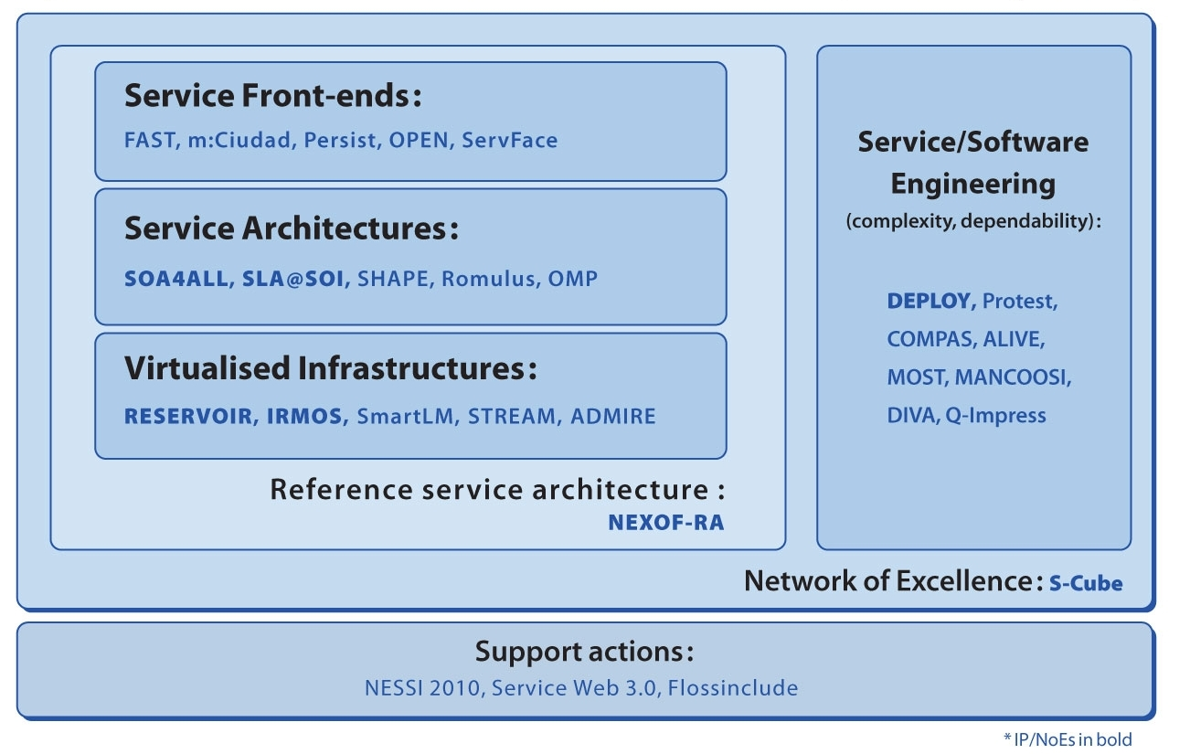
Call 1: EU contribution = €120 million
http://cordis.europa.eu/fp7/ict/ssai/projects-call1_en.html

Slide 35
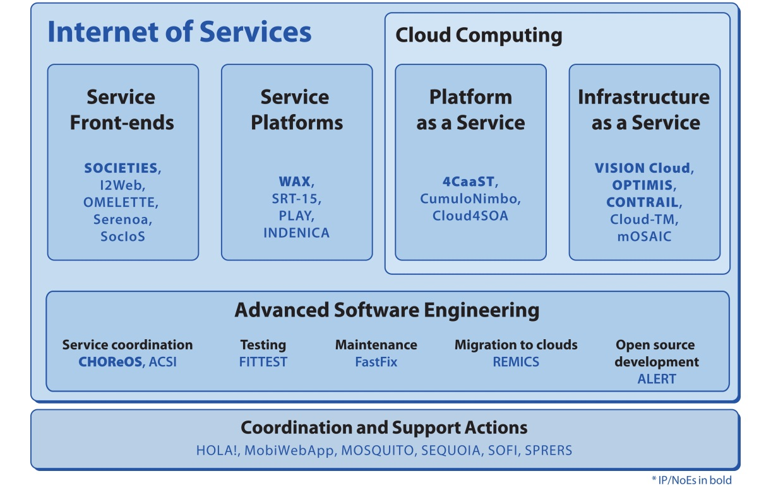
Call 5: EU contribution = €110 million
http://cordis.europa.eu/fp7/ict/ssai/docs/2010-3197-call5factsheets-final.pdf
*SPRERS is a Call 4 coordination and support action

Slide 36
Internet of Services
Cloud Computing
PaaSage
Celar
LEADS
BigFoot
CloudSpaces
HARNESS
OpenI
Broker@Cloud
COMPOSE
CloudScale
BETaas
Advanced Software Engineering
MODAClouds
ARTIST
PROWESS
U-QASAR
MIDAS
MARKOS
RISCOSS
OSSMETER
Coordination and Support Actions
PROSE
OCEAN
SUCRE
OCEAN, PROSE, SUCRE
Call 8: EU contribution = €70 million
http://cordis.europa.eu/fp7/ict/ssai/docs/projects/factsheets-call8-brochure.pdf

Slide 37
Cloud Computing
Software & Services
Heterogeneous clouds & IoT
Cloud networking
Cloud reliability
Agile software prototyping
PANACEA
SeaClouds
CACTOS
SynchFree
HEADS
ASCETiC
MONDO
S-CASE
ORBIT
Quality of Service
Big Data
ENVISAGE CloudWave
CoherentPaaS
Coordination and Support Actions
CloudWATCH CloudingSMEs HTML5Apps CLOUDCATALYST
Call 10: EU contribution = €41.5 million

Slide 38
Focus of Call 10 projects (1)
PANACEA: addresses the ability of self-recovery after failure
SeaClouds: supports orchestration of modules across the cloud
CACTOS: optimise deployment based on dedicated simulation techniques
SynchFree: conflict-free replication of data in the cloud
HEADS: framework to manage heterogeneity of the network
ASCETiC: aims to reduce energy consumption
ORBIT: new paradigm for virtualised resource consolidation

Slide 39
Focus of Call 10 projects (2)
MONDO: increased scalability of models used in software engineering
S-CASE: agile paradigm to automate mapping of user requirements to software development
CoherentPaaS: federated query language to access multiple data sources
ENVISAGE: open-source framework to develop SLA-aware services; automated analysis using formal methods
CloudWave: agile development of adaptive cloud services providing end-to-end QoS

Slide 40
Main beneficiaries: FP7 Call 10

Slide 41
Top beneficiaries: FP7 Call 10

Slide 42
H2020 Work Programme preparation
Public consultation: 27 Feb – 17 Apr 2013
Objective 1: Advanced cloud infrastructures and services (3/4 of resources)
  High performance heterogeneous cloud infrastructures
  Federated cloud networking
  Dynamic configuration, automated provisioning and orchestration of cloud resources
  Automated discovery and composition of services
  Cloud security

Slide 43
H2020 Work Programme preparation
Public consultation: 27 Feb – 17 Apr 2013
Objective 2: Tools and methods for software development (1/4 of resources)
  Software tools and methods for large complex and data-intensive systems
  Software architectures and tools for highly distributed applications

Slide 44
H2020 Public Consultation
Public Consultation launched on 26 February 2013
42 contributions received by 2 April 2013
30 speakers invited
26 presentations and 72 participants on 17 April 2013
All contributions, all presentations, full report and slides available at:
https://ec.europa.eu/digital-agenda/en/public-consultation-advanced-cloud-infrastructures-and-services

Slide 45
Steps towards the H2020 launch
First draft of Work Programme: summer 2013
European Commission inter-services consultation: autumn 2013
Consultation of the EU Member States: autumn 2013
Networking activities during ICT 2013, Vilnius, 6-8 Nov 2013
http://ec.europa.eu/digital-agenda/en/ict-2013
WP2014 adoption + first H2020 call: mid-December 2013
Deadline for submission of proposals: April 2104

